Slide 1
Employee Data Analysis using Excel
STUDENT NAME: S.SWETHA
REGISTER NO : 312220783
494CA12FBE0014BB1FA456C2A98C69B0
DEPARTMENT : B.com(GENERAL)
COLLEGE : Arulmigu Kapaleeswarar Arts And Science college

Slide 2
PROJECT TITLE
Employee Performance Analysis using Excel

Slide 3


AGENDA
Problem Statement
Project Overview
End Users
Our Solution and Proposition
Dataset Description
Modelling Approach
Results and Discussion
Conclusion
3/21/2024 Annual Review

Slide 4

PROBLEM STATEMENT
Employee performance is defined as how well a person executes their job duties and responsibilities. The companies assess their employees performance on an annual or quarterly basis to define certain areas that they need improvement and to encourage further success in the expected areas.
The Dataset overview of an employee, contains the information about employees in a company, including their educational backgrounds, work history, demographics and employment related factors.

Slide 5

PROJECT OVERVIEW
The project involves analyzing employee data using Excel which helps in gaining the knowledge regarding organizational data, performance statistical analysis by creating visualizations to understand the employee performances.

Slide 6

WHO ARE THE END USERS?
The end users in employee performance analysis include:
1. Human Resource management professionals.
2. Data Analysts.
3. Team Leaders.
4. Superiors.
5. Department supervisors.

Slide 7

OUR SOLUTION AND ITS VALUE PROPOSITION
*Filtering- purpose to fill the missing values.
*Conditional formatting- blank values.
*Usage- Pivot table and data chart.

Slide 8
Dataset Description
Employee data set- Kaggle
There are 26 features
The important ten features are,
Employment ID
First name
Last name
Gender
Employee status
Employee type
Employee classification
Performance score
Current employee ratings
Business units

Slide 9

THE "WOW" IN OUR SOLUTION
Performance Level– These include the categories such as Levels in very high, high, medium, low, etc...
Using Pivot table and charts for analysing the employees performance.
3/21/2024 Annual Review
9

Slide 10
MODELLING
The modelling in this employee performance analysis project includes the following:
*Data collection
*Data cleaning
*Techniques
*Results
*Pivot table
*Chart graphs
10

Slide 11
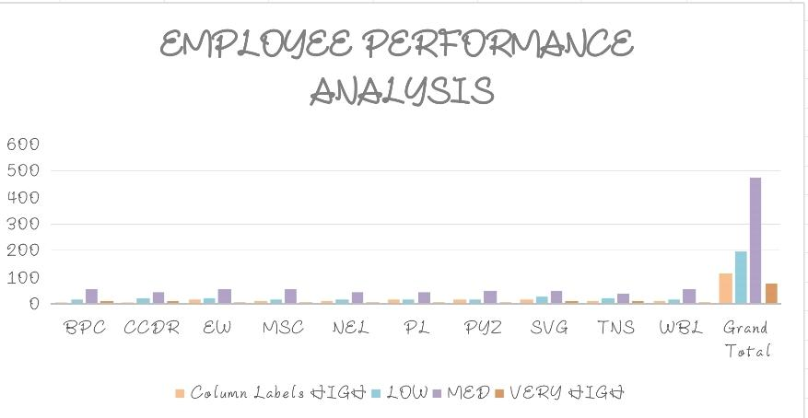
RESULTS
11

Slide 12
conclusion
To conclude, the employee data analysis reveals the key insights in workforce performance and areas needed for improvement. By analyzing the data such as productivity, turnover rates and engagement levels, these organizations can identify the strengths and weakness in their workforce environment. This analysis supports decision-making, enabling targeted inventions to enhance employee performance and improve overall organizational effectiveness. The effective data analysis provides a foundation for the improvised planning and operational developments, which leads to a motivated and productive workforce environment.

